Slide 1


ProjectManagerSimulation

Slide 2
Problem Statement & Solution
Problem Statement:
Develop an AI agent capable of learning and making decisions in a grid-based game environment. The agent's objective is to navigate through the grid by taking a sequence of actions to complete specific tasks while receiving feedback from a human player. The challenge lies in training the agent to choose the right actions through reinforcement learning, adapting its behaviour based on human feedback, and successfully completing predefined correct action sequences for different states in the grid.
Solution:
This solution revolves around creating an AI agent capable of navigating a grid-based game environment, completing tasks, and learning from human feedback. This solution demonstrates a systematic approach to building an AI agent that learns from human feedback, navigates a grid-based environment, and accomplishes tasks using reinforcement learning techniques. By ingeniously balancing reinforcement learning and human-guided decision-making, the agent emerges as a proficient problem solver within the context of the game.
Steps Involved:
Environment Setup
Reward design
Human Feedback Integration
Q-Learning Agent
Training Loop
Iterative Refinement
Evaluation and Testing

Slide 3
Use case – Process Flow
Environment Setup:
-Create a grid-based game environment with different states and actions.
-Define the initial state and end goal for the agent's navigation.
2.Reward design:
-Design a reward system that quantifies the desirability of transitioning between states.
-Ensure that rewards promote desired behaviour, such as reaching the end goal or completing tasks.
3.Q-Learning agent Initialization:
-Set up a Q-learning agent with an empty Q-table.
-Define hyperparameters such as initial learning rate, discount factor, and exploration probability.
4.Human Feedback Integration:
-Implement a mechanism to prompt the human player for feedback after each action.
-Incorporate the feedback into the reward calculation, adjusting the reward based on the player's assessment.
5.Training Loop:
-Initiate a training loop over multiple episodes.
-Update Q-values using the Q-learning update equation based on rewards, feedback, and exploration.
6.Iterative Refinement:
-Adjust hyperparameters, reward structures, or feedback mechanisms to enhance the agent's performance.
7.Evaluation and testing:
-Run evaluation episodes to assess the trained agent's performance.
-Calculate metrics such as total rewards and correct actions to understand the agent's competence.

Slide 4
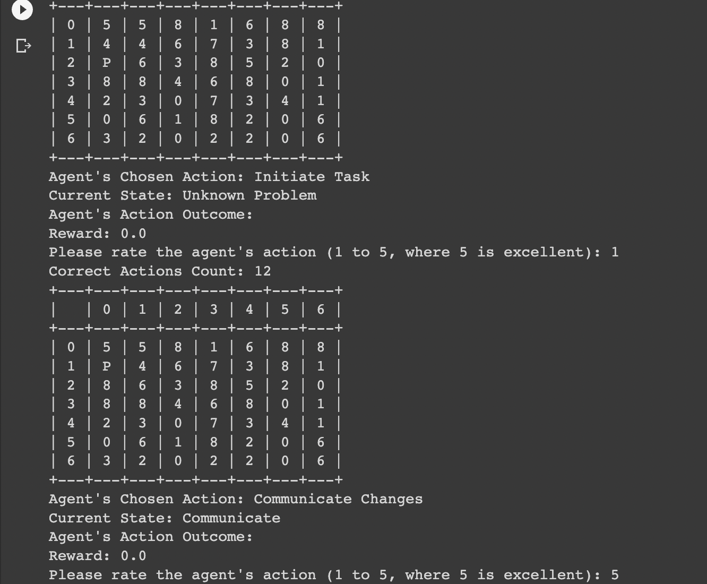
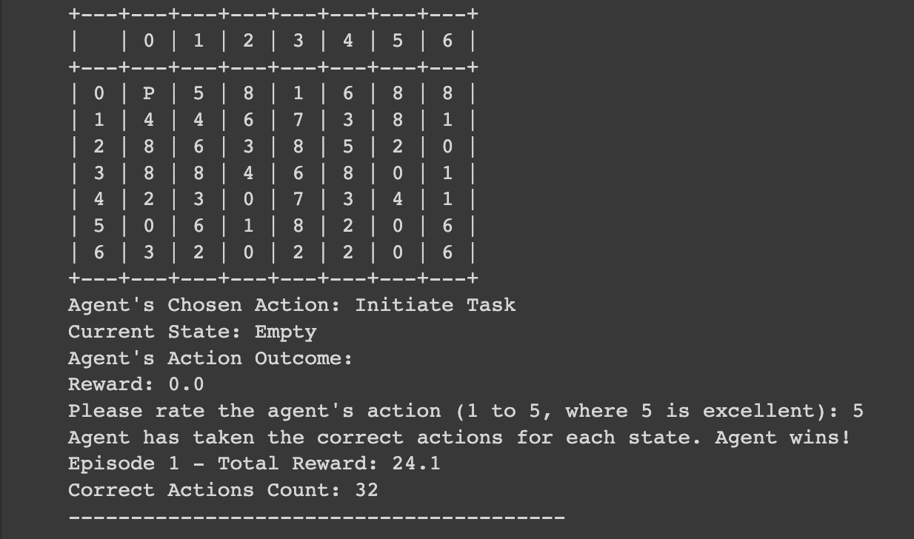
Results
One of the Iterations: End Result:

Slide 5
Benefits
1.Real-World Application:
-Project management simulations mirror real-world scenarios, making the project relevant to industries where efficient task management is crucial.
2.Problem Solving:
-You'll encounter challenges in designing reward structures and optimizing agent behavior, enhancing your problem-solving abilities.
3.Customizable Environment:
- You can adapt the project to simulate different project management scenarios, tailoring it to various use cases.
Overall, it offers a multidimensional learning experience that combines AI, simulation, project management, and human feedback.
Future Work
While this project has made substantial progress, several avenues for future development are evident, such as enhancing user interface, dynamic environments, exploring more advanced reinforcement learning algorithms, incorporating diverse forms of Human Feedback, etc. As technology advances and AI capabilities grow, the potential for optimizing project management processes and decision-making continues to expand.

Slide 6
THANKS!
K SRIKAR
Email-srikar.k@criticalriver.com

